Slide 1



ICB Dental Update
26 April 2025
Carole Crathern
Head of Primary Care Commissioning - Dentistry and Optometry

Slide 2
Background - Delegated commissioning
NHS Sussex became responsible for commissioning Pharmacy, Optometry and Dental (POD) services on 1 July 2022
Previously this function was performed by NHS England
Sussex were an ‘early adopter’ system along with eight other ICBs, including the rest of the South East
Sussex is helping to lead the way in developing responses to local dental system transformation, working closely with the South East Commissioning Hub dental contracting team and other ICBs in the region

Slide 3
Dental Contracting
NHS dental services are delivered through:
General dental practices (high-street practices) for most of the population
Specialist dental services – delivering more advanced care such as oral surgery and complex restorative treatment
Community dental services – delivering dental care for children and adults who have additional needs
Hospital dental services - referral centres for those patients who require access to secondary care skills and facilities
There are around 228 contracts for Mandatory Dental Services (MDS) services in Sussex
Activity/ Performance
NHS dental providers are commissioned to deliver an agreed number of Units of Dental Activity (UDAs)
Various treatments attract different charges based on bands, these represent different numbers of UDAs
There are four bands of charges for dental treatment. Each band of NHS dental treatment (Band 1, 2, 3 and Urgent Band) equates to a number of UDAs
7,000 UDAs equates to around 1 full time dentist
Providers are contracted to provide a set number of UDAs for an agreed price from 1 April until 31 March
Total contract value paid in monthly instalments
Recovery if provider does not deliver 96% of their contract activity at year end

Slide 4
Enhancing access to NHS dental services – a critical national and local priority
Ensuring adequate primary care dentistry provision universally as well as for the groups with the highest level of oral health need is one of the greatest immediate challenges for Sussex
Multifaceted factors impacting on dental access:
High numbers of contract hand-backs
Provider under-delivery against contract
Higher acuity of dental need/ patient complexity
Workforce challenges

Slide 5
Our response to the challenge
To mitigate losses in dental activity (from contract handbacks and underperformance) and improve patient access to NHS dental care we have made significant progress delivering key priorities for our population.
This has been built on:
Scoping data and insight, with provider and public engagement
Working with Public Health (NHSE regional and Local Authorities) to better understand our population’s oral health need
Testing approaches with stakeholders for clinically-led co-developed initiatives
Responsiveness to incoming guidance/ reform measures
Exploring opportunities for flexible commissioning
Local implementation of national Dental Recovery Plan to enhance patient access to NHS dentistry by increasing activity and supporting workforce transformation
Identifying priory areas of work and inform the development of a Sussex Dental Recovery and Transformation Plan https://www.sussex.ics.nhs.uk/wp-content/uploads/sites/9/2024/09/2.6-Dental-Recovery-Plan.pdf

Slide 6
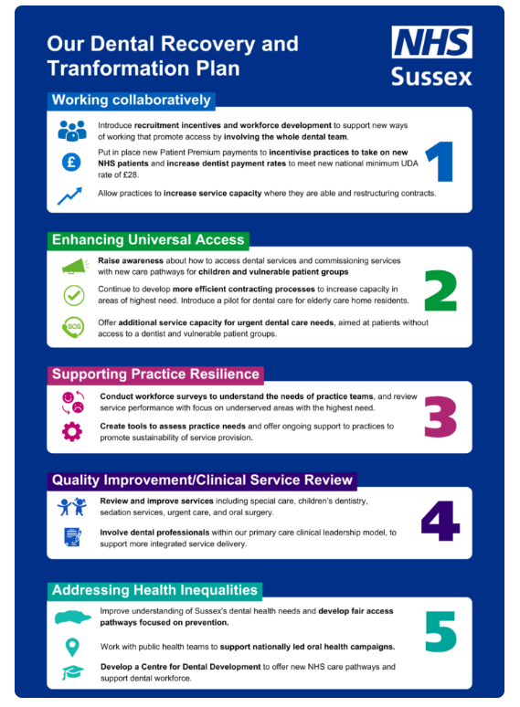
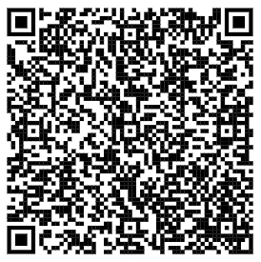
Our response to the challenge
Sussex Dental Recovery and Transformation plan
On 25 September 2024 the NHS Sussex Board approved a comprehensive plan at its meeting in public, which aims to continue work to increase NHS dental activity and support the people of Sussex to access the care they need when they need it.
Aligned to the national plan to recover and reform NHS dentistry published in February 2024 and 2025/26 NHS England (NHSE) planning guidance.
https://www.sussex.ics.nhs.uk/sussex-launches-dental-recovery-and-transformation-plan-to-help-improve-access-to-nhs-dentistry/

Slide 7
High-level overview of NHS Sussex dental objectives
1. Implement National Dental Plans
2. Enhancing Access
3. Supporting Practice Resilience
4. Quality Improvement/
Clinical Service Review
5. Addressing Health Inequalities
Additional urgent appointments
Uplift of minimum Unit of Dental Activity (UDA) value to £28​
​
New Patient Premium rollout​
​
Promote and support use of skill-mix
​
‘Golden hello’ workforce incentivisation initiative​
​
Support Local Authority (LA) led ‘Smile for Life’ oral health improvement activity
​
Enable existing contractors to deliver additional capacity where able (up to 110% of contract)​
​
Contract rebasing exercise to address persistently under-performing contracts​
Communications and engagement strategy
Utilise flexible commissioning to deliver enhanced services that support children & vulnerable groups
Rapid commissioning of permanent UDAs
Temporary UDA scheme
Additional Hours Scheme
Extend Urgent Dental Care and Stabilisation pilot
Weekend and bank holiday; Advice, Analgesia and Antimicrobials scheme
Domiciliary dental care pathway pilot
Sussex Dental Workforce Survey
Collaborative workforce development initiatives
Performance dashboard to monitor delivery by LA area
Use flexible commissioning guidance to enhance practice resilience based on South East framework principles
Commissioned dental service procurement pipeline
Clinical Service Reviews:
Special Care and Paediatric Dentistry (SCPD)
Sedation services
Unscheduled dental care
Oral Surgery
Options appraisal to inform future commissioning intentions
Clinical service review and service development –recommissioning/ reconfiguration
Clinical Leadership support model
Improve understanding of Sussex population oral health need
Develop pathways to address inequalities of oral health and dental access, applying a Making Every Contact Count (MECC) approach, based on public health prioritisation, within a prevention-based model
Scope opportunities for a Sussex Centre for Dental Development to enhance access and support sustained expansion of workforce supply and optimal use of skill mix to deliver new models of care.
  Align local activities with national oral health promotion campaigns

Slide 8
Achievements in the last 18 months
New contracts procured, e.g. Worthing & Brighton
Implemented a new initiative to rapidly procure more permanent activity in targeted areas, e.g. Lewes
Commissioned temporary activity, e.g. Mid Sussex
Agreed contractual over-performance of up to 10% for providers with capacity
Tested an alternative approach to provide Urgent Dental Care and Stabilisation (UDCS) with 10 providers in areas of highest need
Expanded the UDCS programme to cover Sussex with around 70 sessions (approx. 490 extra appointments) to be delivered per week
Introduced the new national patient premium across Sussex (from March 2024)
Uplifted the minimum UDA value from £23 to £28
Implemented a ‘golden hello’ Dental Recruitment Incentive Scheme (DRIS) in targeted areas
Started work with system partners to develop the dental workforce and enhance access to NHS dental care within a Sussex Centre for Dental Development
Worked with public health system partners, clinical leaders and dental professionals to plan delivery of initiatives aimed at improving the oral health of children and young people
Developed data and insight to understand the current and future oral health needs of the Sussex population

Slide 9
Our response to the challenge
Action | Rationale | Impact
Geographically targeted re-procurement in areas experiencing the highest reduction of UDAs This included a ‘rapid commissioning’ initiative to offer permanent UDA increases | To mitigate activity losses Targeted at areas with lower rates of activity per head of population compared with similar Index of Multiple Deprivation (IMD) areas To stabilise NHS dental provision in Sussex by reducing the risk of further dental contract hand-backs due to uncertain funding | 75,000 additional permanent UDAs (Worthing, Brighton & Hove and Lewes)
Commissioning temporary UDAs | To address immediate activity losses due to contract hand backs whilst more longer-term provision is implemented | Temporary UDAs commissioned

Slide 10
Our response to the challenge
Action | Rationale | Impact
Agreed contractual over-performance of up to 10% for those with capacity | To address underperformance across Sussex | 2024/25 – up to 75,895 UDAs across 58 contracts (equivalent of 10.8 full time dentists)
Continuation of Additional Hours scheme (AHS) until 31 March 2025 | To increases access to Urgent Dental Care (UDC) for new and clinically vulnerable patients AHS provision incorporated into UDCS programme from 1 April 2025 to provide consistent offer | 6 providers offering max of 1,118 contracted sessions per year across Sussex
Implementation of new minimum UDA rate from 1 April 2024 | To support practice and contract sustainability | Applied with no loss of commissioned activity
South East Provider Resilience Framework - mechanism to assess individual applications from practices experiencing challenges due to exceptional circumstances | To support practice and contract sustainability To help stabilise NHS dental provision | Applications currently being assessed

Slide 11
Our response to the challenge
Action | Rationale | Impact
Domiciliary Dental Care pilot One-year pilot underway (Crawley) – using dental therapists in general dental practice (GDP) to provide domiciliary dental services to elderly care home residents Provision of screening and treatment, alongside oral health promotion and upskilling for care home staff | To help address current service gaps to universal dental access for elderly care home residents To test Dental Care Professional (DCP)-led care model of care Optimal use of skill mix | Evaluation will develop ICB understanding and inform future commissioning intentions Scoping opportunities to scale/adapt model in 2025/26
Local implementation of the national Dental Recruitment Incentive Scheme (DRIS) | To offer ‘golden hellos’ to incentivise recruitment of dentists into areas that persistently struggle to attract dentists into NHS work | 17 Golden Hellos approved – recruitment underway with 7 new dentists ICB-led Community of Practice – sharing best practice around recruitment and retention

Slide 12
Additional UDC capacity
Action | Rationale | Impact
Urgent Dental Care and Stabilisation (UDCS) programme - an enhanced urgent care service including urgent assessment and oral stabilisation targeted at need Pilot across 10 providers in 2024/25 with full evaluation Expansion from January 2025 Aligned to national NHSE planning guidance 2025/26 – Sussex goal of 26,546 additional annual UDC appointments Offering appointments to patients without access to a regular dentist and vulnerable patient groups requiring urgent assessment | To increase access to UDC for new patients and vulnerable patients To test and optimise sessional flexible commissioning arrangements (remuneration that incentivises provider participation) To improve the oral health of the Sussex population, mitigating the widening of health inequalities To help relieve pressures on other parts of the health care system (e.g. A&E) To test sessional data collection tool with NHSBSA to effectively describe health outcomes and inform commissioning intentions https://www.nature.com/articles/s41404-024-2634-9 | During 12-week pilot 10 providers saw 514 patients (922 UDAs/106 sessions with average of 4.9 patients per session) Targeting health inequalities High risk patients Expansion underway – currently our sites across Sussex are delivering 67 sessions per week (469 appts per week)

Slide 13
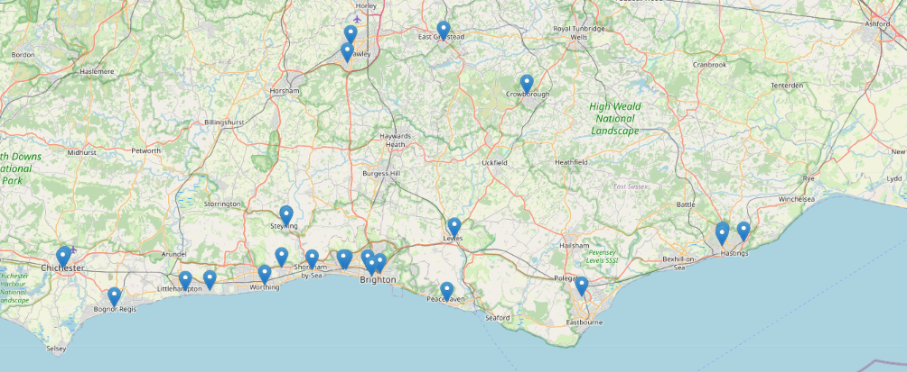
UDCS in Sussex
Distribution of UDCS sites across Sussex (April 2025)

Slide 14

Signposting patients to support access
Local NHS dental services:
NHS Find a Dentist website
https://www.nhs.uk/service-search/find-a-dentist
Access to additional capacity from UDCS and AHS sessions:
Sussex Dental Helpline
0300 123 1663
08:00 to 16:00hrs
Monday to Friday

