Slide 1
Using social media as a PPG
A simple, safe guide to Facebook
Harriet Rayfield – Communications and Engagement Manager

Slide 2
Today’s session:
A gentle introduction to using Facebook as a PPG
No technical experience needed
What’s right for your PPG?
Plenty of time for questions

Slide 3
What we’ll cover
01 | Deciding your purpose and audience
02 | Facebook pages and groups
03 | Running a page safely and effectively with low workload
04 | Confidentiality and security
05 | Engaging with your community

Slide 4

Start with your purpose and audience
Why do we want to use social media?
Who are we trying to reach?
What value will people get from following us?
This is key to decide before you get started – it will help keep things manageable and make sure being on social media is worthwhile.

Slide 5
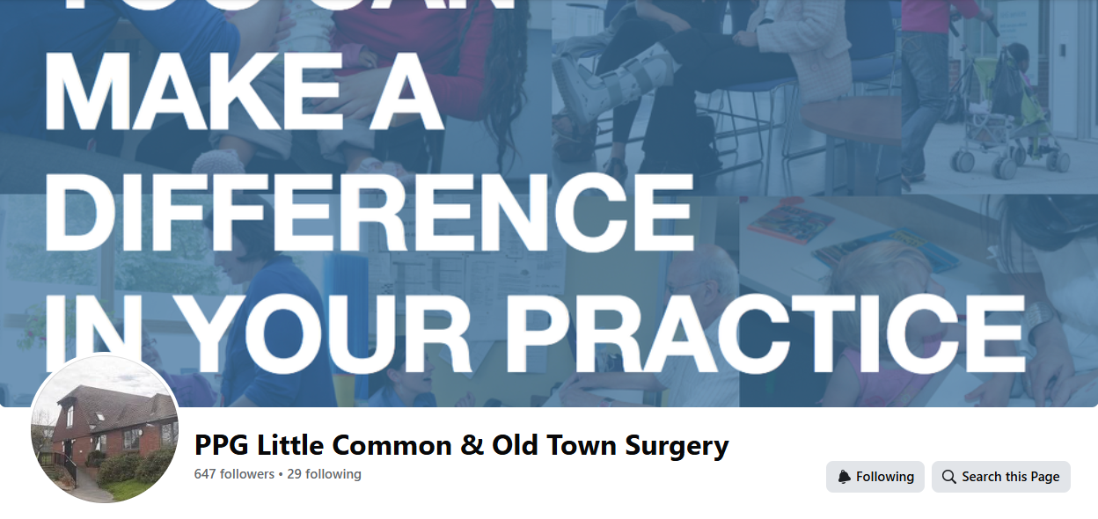
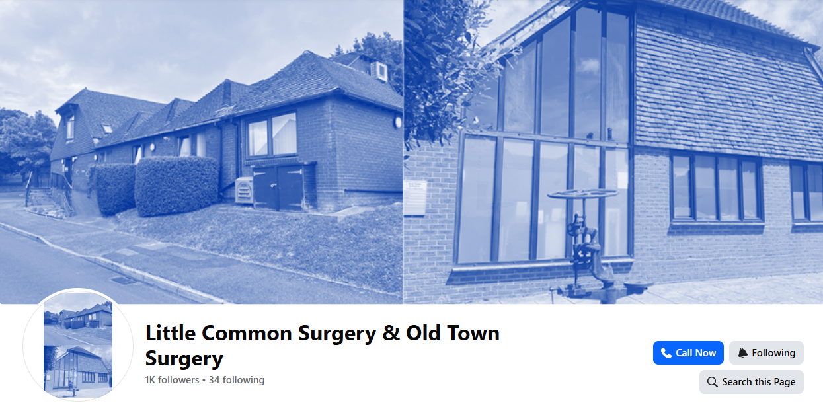

What can you offer that the practice can’t?
Strengthening the patient voice
Community connection
Broadening PPG membership
It’s important that you are supporting and complementing the practice page – not duplicating it.
Example: Little Common and Old Town Surgery (click the images to visit pages)
Notes:
Most patients will naturally follow the GP practice page, not the PPG. So what can you offer that they can’t?
Strengthening the patient voice – surveys, feedback, engagement opportunities (something the practice often can’t do as openly/not a priority)
Community connection – sharing local wellbeing activities, support groups, events (PPG is a bridge between practice and community)
Broadening PPG membership – lower effort alternative to stay informed or contribute as a PPG member
A great example is Little Common and Old Town Surgery and the difference between their surgery page and the PPG. Surgery is focused more on operational information (opening hours, IT issues, health conditions, new/changing services, practice updates) and the PPG page shares events, surveys, volunteering opportunities, wider support services.

Slide 6
When a Facebook presence is NOT a good idea
You don’t have time to post regularly (at least weekly)
There is no clear purpose beyond duplicating the practice page
The PPG is very small or inactive
There’s no capacity to manage/reply to comments
Are there better alternatives? – newsletter, waiting room screens/posters
Notes:
Don’t feel pressure to be on Facebook just because others are

Slide 7

Pages vs Groups
Start with a page:
  Clear public presence
  Low expectation of conversation
  Easier moderation
  Feels ‘official’ and safe
  Can stick to simple sharing to begin with
Notes:
A group can work later, if:
The PPG is active and confident
Members want discussion and ideas
Clear moderation is in place
Time is available to manage conversations
I’ll talk about other ways you can use Facebook groups later without setting up your own

Slide 8
Setting up a Facebook page
Create a page using instructions on Facebook
Make sure the name is clear and reflects your community and purpose
Add at least two administrators – you must have a personal Facebook profile to set up and manage a page
Share a welcome post which sets out who you are as a PPG and your aims – it may also be useful to share what your page is NOT for (i.e. medical advice)
Notes:
I’ve purposely not included too many screenshots for ‘how to’ as this process changes regularly, but the Facebook/Meta help pages are always up to date

Slide 9

Posting – keep it simple
1-2 x a week is enough – regular activity builds trust and improves engagement
Share posts from the NHS or practice pages (but your posts should stick to your purpose – too much duplicating removes the need for your own page)
Prepare and schedule posts in advance – draft a simple content calendar or decide on a regular posting day/rhythm
Share responsibility between admins

Slide 10
Responding to comments
Be polite and friendly – reflect the personal, community-led nature of PPGs
Agree on a response time (i.e. within 3 working days) and communicate this in your Facebook bio – or let people know that the page isn’t monitored for comments if it’s purely for information sharing, not engagement
Do not give medical advice, share complaints or personal stories, or offer opinions on political/controversial topics
Where possible, direct people to the lead organisation or your PPG email address to streamline feedback and reduce your admin on Facebook
Remove/hide any comments that are abusive or share personal details
Limit who can comment on individual posts if you are not looking for feedback
Notes:
Responding to comments or messages is really important to give your page value and credibility. However, I recognise this can be worrying or seen as an extra job to do. Here are some tips and reassurances.

Slide 11
Confidentiality, boundaries and security
Never share patient information
Facebook makes it easy to ensure you are keeping your personal Facebook use separate and private - always check you are ‘switched in’ to the PPG page before posting/responding
Make sure each administrator has two-factor authentication (2FA) set up on their personal Facebook profiles to prevent hacking

Slide 12



Engaging with your local community - groups
You don’t need to run a Facebook group to reach far more local people
You can join many Facebook groups as a page (but not all)
Post as your PPG page into Facebook groups such as ‘Seaford Notice Board’
Good things to share in groups – surveys, local events, invitations to join the PPG – helpful information for the whole community
Visit ‘Groups’ on left-hand toolbar and search to find/join ones in your area

Slide 13

Content ideas
Introduce yourselves – who we are and what we do
Promote practice or PPG activities – meeting dates, surveys, events
Share NHS campaigns – simple share from official NHS pages rather than writing your own
Local wellbeing and community support – add value beyond the practice page
Try out some engagement posts – have you had your flu jab yet?, meeting time polls

Slide 14
Start small…
Keep things simple and manageable based on your capacity/confidence
After 3-6 months, ask ‘is this sustainable?’, ‘is it adding value?’, ‘are more patients engaging with us/aware of the PPG?’ – it’s okay to close if not working!
Being on social media is a ‘nice to do’, not an essential

Slide 15

Top tips…
Link in with the practice from the start – how can you support each other?
Keep posts short and simple in plain English
Use eye catching images or graphics that aren’t too busy – make sure you have permissions for photos (pexels.com, pixabay.com and unsplash.com are good sites for stock imagery)
Don’t take it personally!
Have some fun with it ☺

Slide 16
Trusted Facebook pages you could link to or follow
National NHS page - Facebook
UK Health Security Agency - Facebook
NHS Surrey and Sussex - Facebook
Your own GP practice
Local community pharmacy
Local hospital trust (East Sussex Healthcare Trust, University Hospitals NHS Trust, Queen Victoria Hospital)
Sussex Partnership NHS Trust (mental health) - Facebook
Sussex Community NHS Trust (community) - Facebook
South East Coast Ambulance Service - Facebook
Local council (East Sussex County Council, West Sussex County Council, Brighton & Hove City Council)

Slide 17
Content ideas
What is a PPG? / ‘did you know…’ - short posts explaining your role
Meet the PPG – mini series introducing people to you as individual members – your role, why you joined the PPG, one thing you’d like patients to know…
Spotlight on – regular post highlighting local organisations or services such as walking groups, carers support, bereavement cafes, community transport, etc
Question of the month – light-touch engagement such as ‘what health topic would you like more information about?’ or ‘what format or time of PPG meetings would work best for you?’ – remember you can use the poll function on Facebook to make this interactive!
What has the PPG been working on? – show the impact your work is having! How many people completed a survey, improvements to the waiting room, etc
Share positive feedback from patients
Photos from events you have held or been involved in
Practical digital support – using the NHS app, ordering repeat prescriptions, booking appointments online
‘Day in the life’/’meet the health professional – could you work with the practice to spotlight different roles i.e. a care navigator? – this would help boost your own Facebook page as well as the practice’s

Slide 18
Any questions?

